Slide 1
Smart Dustbin

Slide 2


Agenda
A
Introduction
Components
Block Diagram
Applications
Conclusion

Slide 3
Introduction
All human being are throws waste in dustbin or some other different places. The waste are plastics, degradable and non-degradable. All people are trying to put the waste in dustbin or garbage bin only. In cities, there are many public places where we see that dustbin or garbage bin are placed but there are overflowing. This create unhygienic condition in the surrounding. And it also create some serious diseases. At a same time, an odour extends throughout the city, and degrading the environment. Recycling bin is really a waste management processing, but they are limited space in a garbage bin, it does not require extra waste.

Slide 4
We must plan the project so that the trash can’t waste and level is measured wheather the dustbin is either full or not.
The hardware for measuring the garbage can is the Node MCU and the ultrasonic sensor.
An IFTTT Webhook, the software component, is accustomed to getting notifications.
The fundamental idea behind this project is that the IFTTT Webhook sends a notification and we receive an email when the waste bin is filled to more than 70%.

Slide 5
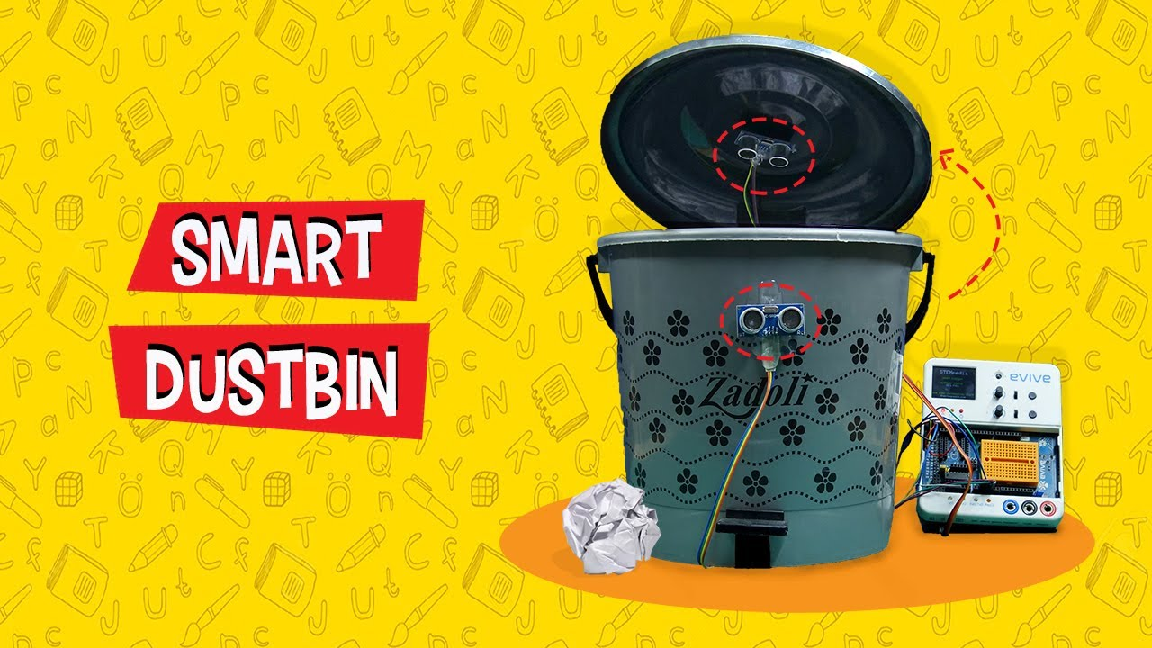

Slide 6
Components
ULTRASONIC SENSOR
NODEMCU
Arduino
LED Display
One Dustbin
Connecting Wires
IFTTT SETUP

Slide 7
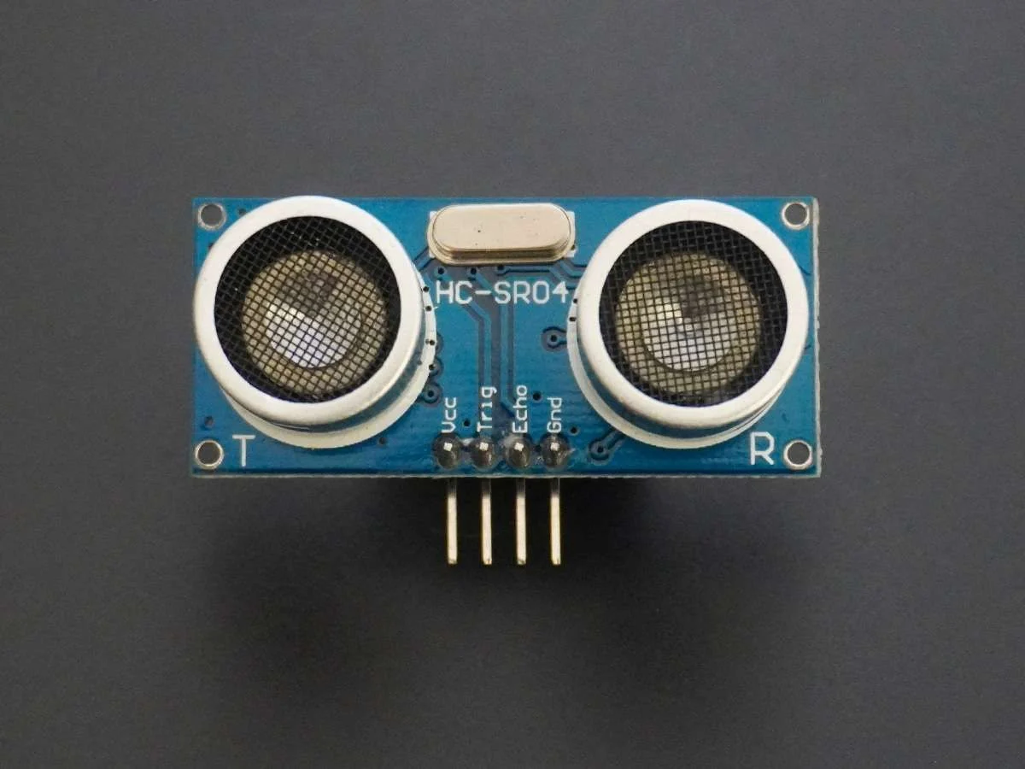
ULTRASONIC SENSOR
A distance is determined with great sensitivity and correct measurements by an ultrasonic sensor. A Ultrasonic sensor have four pins. Two pin are VCC , GND the other two pin are: The information would be supplied by the trig pin, while it would be absorbed by the echo pin.
Distance = Time*Velocity of sound/2/2
Where Time= is the time transmitted and received between an ultrasonic wave.

Slide 8
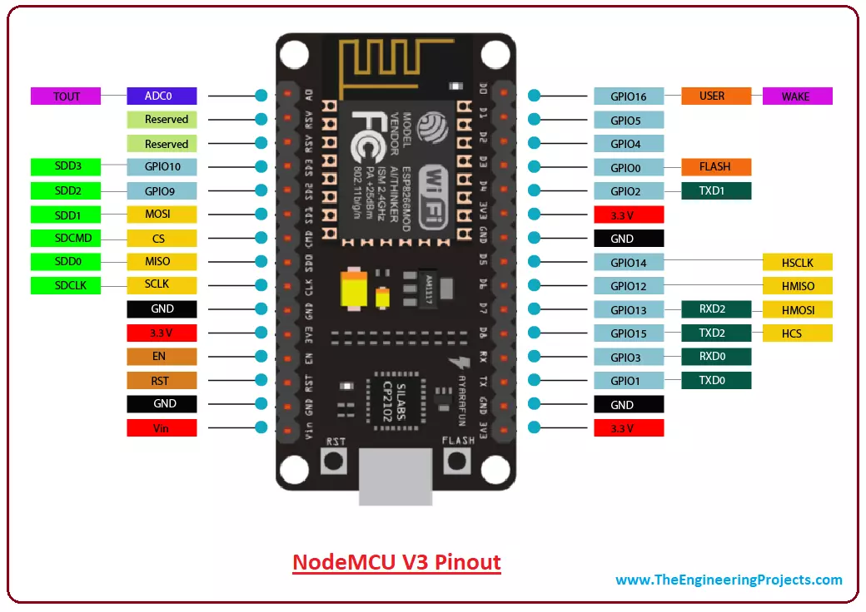
NODE MCU
Node MCU is an open-source IoT project that is completely free and it is used for Wi-Fi to make things work. A Node MCU can powered through a USB port and this pin can be supplied with regulated 3.3v to power the board. There are 16 general purpose input-output pins for Node MCU.

Slide 9
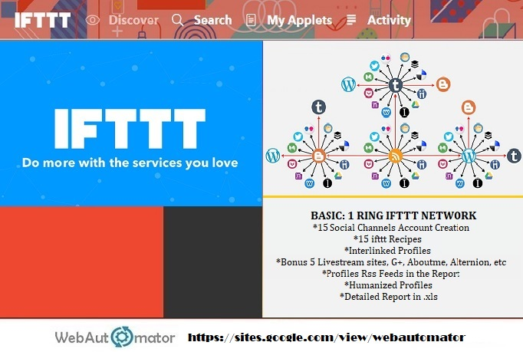
IFTTT SETUP
IFTTT is commonly referred to as a web-based service that allows users to connect between web services as IF This Then That. To create conditional trigger chains that work on certain websites, including Microsoft outlook and Twitter message and Facebook. The conditional chains are referred to as applet.

Slide 10
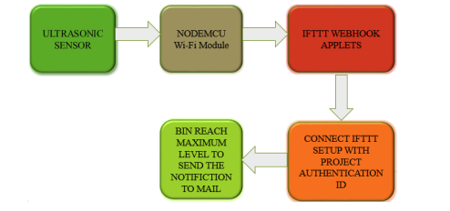
Block Diagram

Slide 11
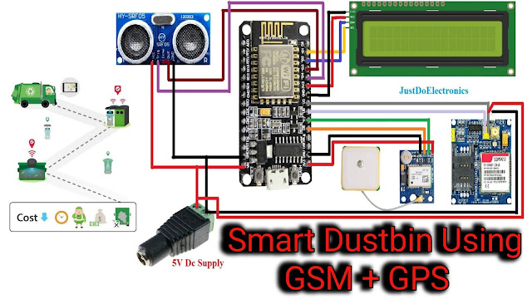

Slide 12
Code
#include <Servo.h>
Servo servo1;
const int
trigPin = 12;
const int echoPin = 11;l
long duration;
int distance=0;
int potPin = A0;
//input pinint soil=0;
int fsoil;
void setup()
{

Slide 13
Serial.begin(9600);
//Serial.print("Humidity");
pinMode(trigPin, OUTPUT);
pinMode(echoPin, INPUT);
servo1.attach(8);
}
void loop()
{
int soil=0;
for(int i=0;i<2;i++)
{
digitalWrite(trigPin,LOW);
delayMicroseconds(7);
digitalWrite(trigPin, HIGH);
delayMicroseconds(10);
digitalWrite(trigPin, LOW);
delayMicroseconds(10);
duration = pulseIn(echoPin, HIGH);
distance=duration*0.034/2+distance;delay(10);
}
distance=distance/2;
Serial.println(distance);
if (distance <15 && distance>1)
{
delay(1000);
for(int i=0;i<3;i++)
{
soil = analogRead(potPin) ;
soil = constrain(soil, 485, 1023);
fsoil = (map(soil, 485, 1023, 100,0))+fsoil;
delay(75);}fsoil=fsoil/3;
Serial.println(fsoil);
Serial.print("%");
if(fsoil>3)
{
delay(1000);
Serial.print("WET "); servo1.write(180);
delay(3000);
}
Else
{
delay(1000);
Serial.print("dry");
servo1.write(90);
}
distance=0;
fsoil=0;
delay(1000);
}

Slide 14
Applications
Resource Optimization
Improved Cleanliness and Hygiene
Encourages Waste Segregation
Data Collection for Better Decision Making

Slide 15
Conclusion
Consider the relevance of a lack of cleanliness anywhere in the workplace, as well
as the necessity to create a more breathable environment.
When the capacity of the dustbin beyond a certain threshold, this mechanism
guarantees that the recycling bin is cleaned.
Vehicles that collect garbage are always working in cities and towns, with an
emphasis on regional development; nevertheless, not all of these dustbins may be
full at all times.
The trash in the city's dustbins will be tracked by this gadget using the suggested manner.

Slide 16
Smart dustbin or garbage bin makes the garbage collection more efficient. Any discarded object that has been passed to a party, a crowded room, a social , a school, or an apartment is considered waste.

Slide 17
Thank You

